Slide 1

EDU-Connect:A Smart E-Learning Platform
group

Slide 2
Overview and purpose
Vision: Revolutionize online education through accessibility and interactivity.
Purpose of Project:
Interactive courses (videos, quizzes, live sessions).
Role-based access (Students, Instructors, Admins).
Progress tracking, certifications, and mobile-friendly design.

Slide 3
BACKGROUND
The rise in number of students has accelerated the need for online and blended learning solutions, highlighting the importance of flexible, accessible, and effective education. Edu-Connect aims to address the challenges facing the traditional education system by providing a comprehensive e-learning platform that connects students, teachers, and resources.

Slide 4
PROBLEM STATEMENT
The traditional education system is facing significant challenges, including limited access to quality education, inefficient learning methods, insufficient support for teachers, and inadequate assessment and feedback mechanisms. Many students, particularly those in rural or disadvantaged areas, lack access to quality educational resources and institutions. Traditional classroom-based learning can be rigid, inflexible, and ineffective for many students, leading to poor academic outcomes. Furthermore, teachers often lack the resources, training, and support they need to provide effective instruction and support to their students.

Slide 5
AIM
To revolutionize online education by providing an accessible, interactive and scalable E-learning platform.

Slide 6
Objectives
Develop a robust and scalable e-learning platform with an intuitive user interface.
Provide students with a seamless learning experience through multimedia content, discussions, and assessments.
Enable educators to create, manage, and monitor courses effortlessly.
Integrate features like progress tracking, certification, and real-time interaction.
Ensure security, scalability, and responsiveness across devices.

Slide 7
Scope of the project
E-Connect will cater to students, teachers, and administrators by offering:
• User Authentication & Role Management (Students, Teachers, Admins)
• Course Creation & Management (Video lectures, PDFs, quizzes, assignments)
• Live Sessions & Discussion Forums
• Progress Tracking & Certification
• Secure Payment Integration for Paid Courses (if applicable)
• Mobile-Friendly & Responsive Design

Slide 8
Stakeholders and their requirements
Students: Accessible courses, progress tracking, certifications.
Instructors: Course creation tools, analytics, monetization.
Admins: User management, security, compliance.
Institutions: Branding, centralized LMS integration.

Slide 9
Technical Feasibility
Tech Stack:
Frontend: React.js (responsive UI).
Backend: Django (Python).
Database: PostgreSQL/MySQL.
Security: JWT/OAuth, SSL encryption.
Scalability: AWS/Firebase cloud hosting.

Slide 10
Business Case
Problem: Lack of flexible, engaging, and scalable e-learning solutions.
Solution:
AI-driven personalized learning paths.
Gamification for engagement.
ROI: Break-even in 2-3 years via subscriptions, partnerships.

Slide 11
Key Risks & Mitigation
Technical Risks:
Mitigation: Prototyping, secure coding practices.
Market Competition:
Mitigation: Unique features (live sessions, adaptive learning).
Budget Constraints:
Mitigation: Contingency fund, phased development.

Slide 12
Research Methodology.
Questionnaires:
learner’s questionnaires,
Instructor’s questionnaires
Admin’s questionnaires
Interviews
Observations
Competitive analysis

Slide 13
Project Plan (Work Breakdown Structure)
Phases:
Initiation → Planning → Development → Testing → Deployment → Maintenance.
Timeline: 6-12 months (Gantt chart visual).
Budget: $1,960 (breakdown: personnel, tech, marketing).

Slide 14
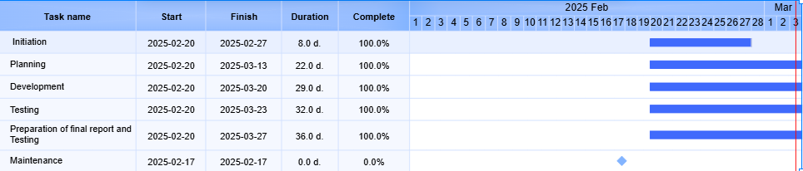
Gantt chart
Illustration

Slide 15
Development & Testing
Frontend: React.js for responsive UI.
Backend: Django APIs, PostgreSQL integration.
Testing:
Unit, integration, security, and UAT testing.
Tools: Jira, Slack, AWS.

Slide 16
Use Cases
Key Scenarios:
Course enrollment, live sessions, assignment grading.
Admin reporting, user feedback.
Visual: Flowchart of user interactions (Students → Instructors → Admins).

Slide 17
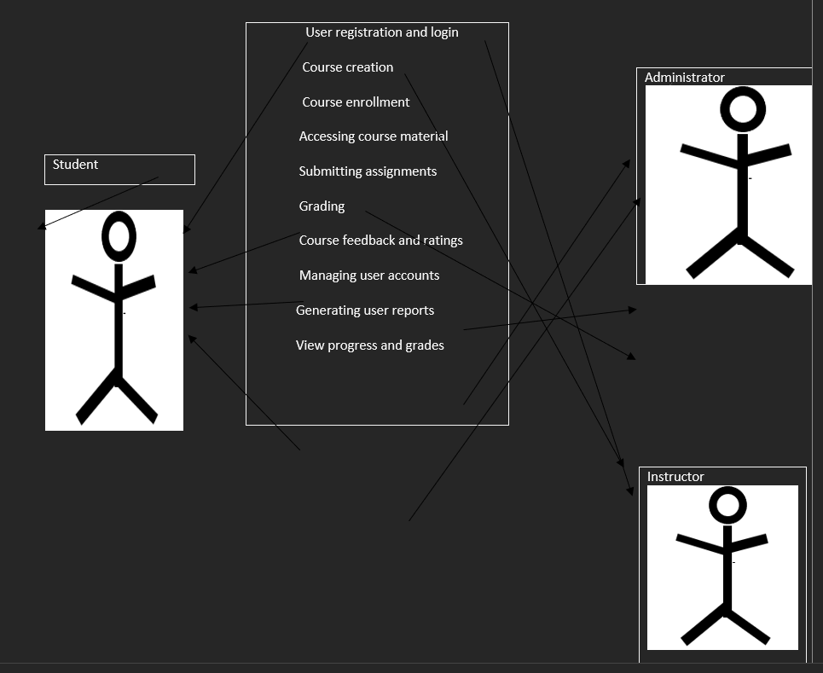
USE CASE DIAGRAM
ACTORS:
STUDENT
ADMINISTRATOR
INSTRUCTOR

Slide 18
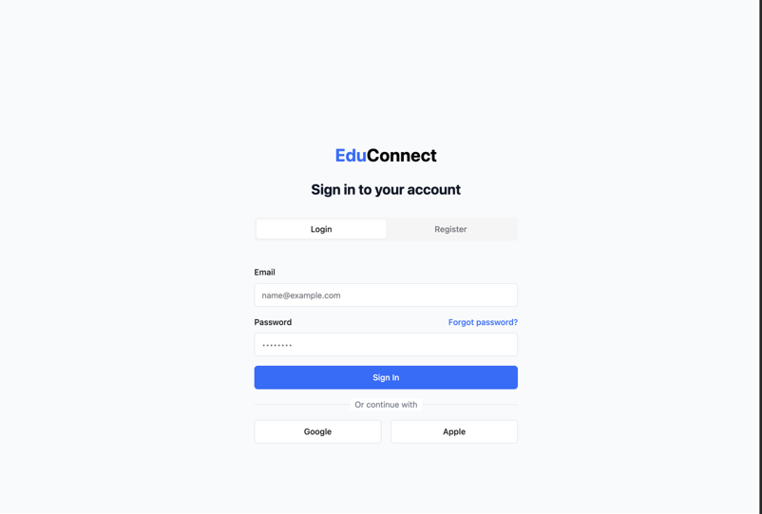
FRONTEND DEVELOPMENT
PART OF THE USER INTERFACES

Slide 19
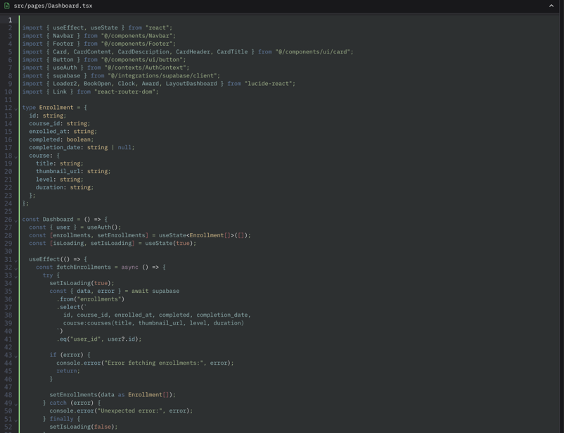
BACKEND DEVELOPMENT
PART OF THE CODE

Slide 20
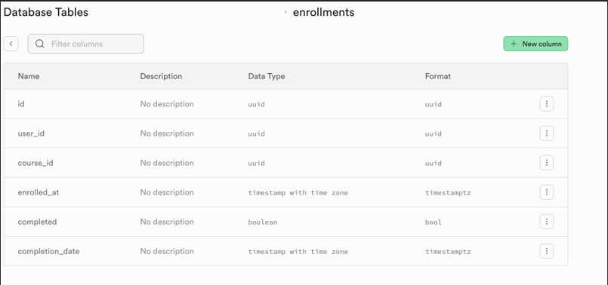
DATABASE TABLES
ENROLLMENTS

Slide 21
Closure & Evaluation
Final Deliverables:
Fully tested platform, user manuals, deployment guides.
Post-Project Review:
Success: On-time delivery, stakeholder satisfaction.
Lessons: Scope management, resource allocation.

Slide 22
Competitive Advantage
AI & Gamification: Personalized learning paths, badges/leaderboards.
Scalable Architecture: Cloud-based, supports 1,000+ concurrent users.
Security: GDPR compliance, PCI DSS for payments.

Slide 23
Expected Outcomes
For Students: Flexible, engaging learning.
For Instructors: Streamlined course monetization.
For Institutions: Centralized digital learning hub.

Slide 24
CHALLENGES AND SOLUTIONS
Challenge: integration of live class features with low latency.
solution: use WebRTC or third party APIs like zoom or Twilo.
Challenge : ensure platform scalability for a large number of users .
solution: implement load balancing and use cloud services like AWS or Azure .
Challenge :scope creep due to changing requirements .
solution :a change management process was implemented to evaluate and approve changes

Slide 25
THANK YOU

